Slide 1
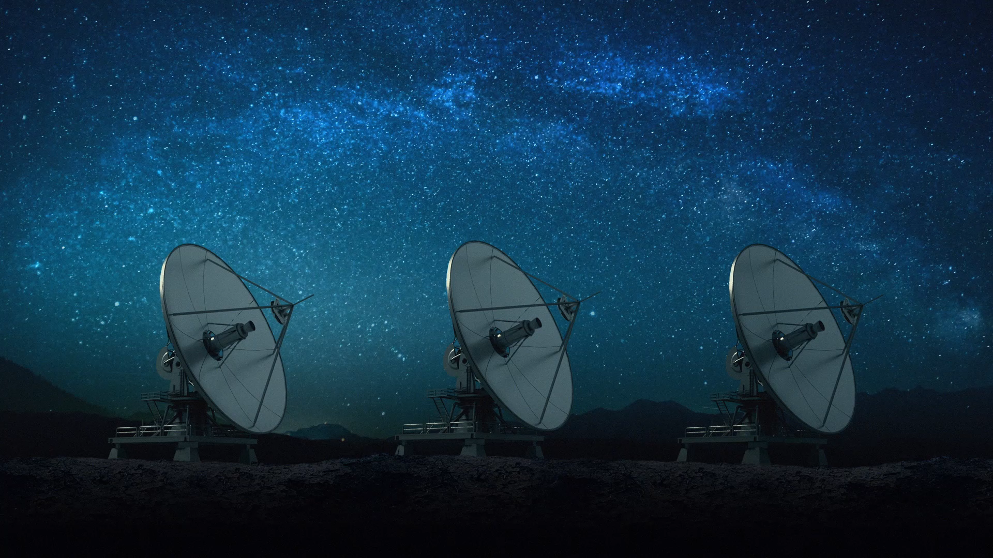
Beacon Receiver and Beacon Transmitter
Embedded Systems Design – Mini Project

Slide 2
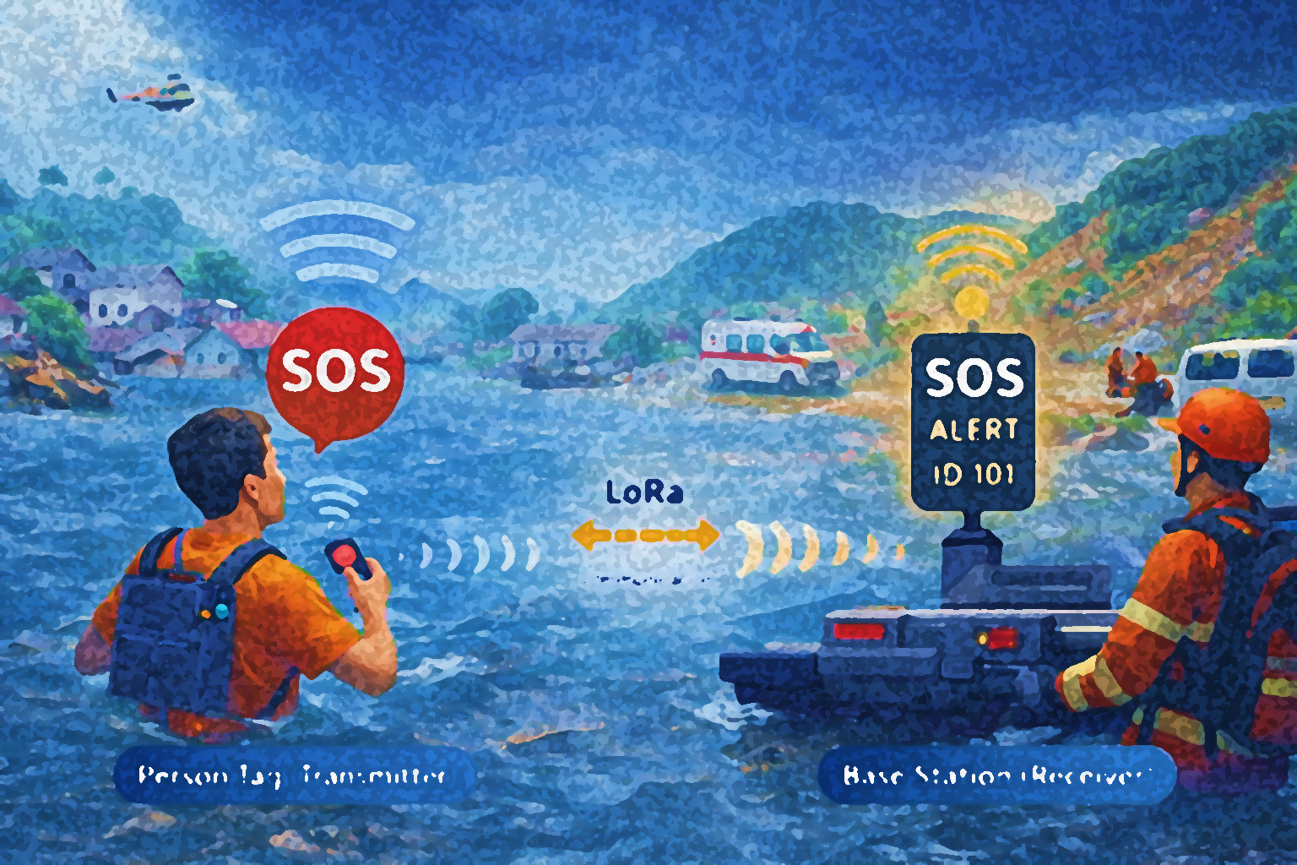
Overview
Introduction
Why this project?
Problem Statement
Proposed Solution
Technologies & Components
System Architecture
Beacon Transmitter (Person Tag)
Beacon Receiver (Base Station)
Challenges We Faced
Prototype Progress
Timeline
Budget
Conclusion

Slide 3

Introduction
This project focuses on developing a LoRa-based wireless beacon transmitter and receiver system designed for emergency communication. The solution enables long-range, low-power alerts even when mobile networks fail during disasters such as floods and landslides. The system consists of a portable tag and a base station that can send and receive SOS and beacon signals reliably.

Slide 4
Why this project?
Floods and landslides in Sri Lanka can damage infrastructure and disrupt networks
During disasters, mobile calls/SMS may fail (power outage, congestion, damaged towers)
Need a low-power, long-range communication method that works without cellular/internet
LoRa is suitable because it supports long range + low energy operation

Slide 5
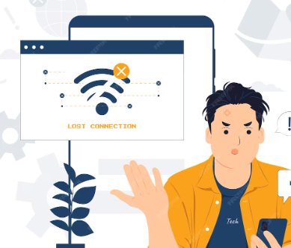
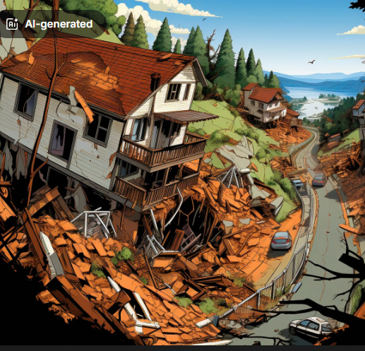
Problem Statement
Problem
People in disaster areas may become isolated and cannot send emergency alerts.
Need a system that:
Works independently of existing network infrastructure.
Can send status beacons + SOS alert reliably over long range.
Helps responders with presence confirmation and last-contact time.

Slide 6
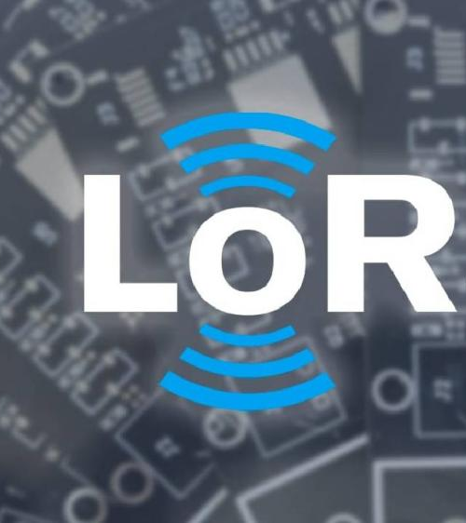
Proposed Solution
A LoRa-based wireless beacon system with 2 main units:
Beacon Transmitter (Person Tag)
Periodically sends beacon message with unique ID.
SOS button sends emergency alert instantly
Beacon Receiver (Base Station)
Continuously listens for LoRa messages
Based on distance LED bulbs alerts give rough idea about distance and when distance is low buzzer will trigger.

Slide 7
Technologies & Components
Hardware
ATmega328P (Tx + Rx controllers)
LoRa RA-02 / SX1278 modules + antennas
SOS push button, LEDs
Buzzer / siren
16x2 LCD display (receiver)
Software
Embedded C / C++ for firmware
LoRa communication library for packet TX/RX and parameter setup

Slide 8
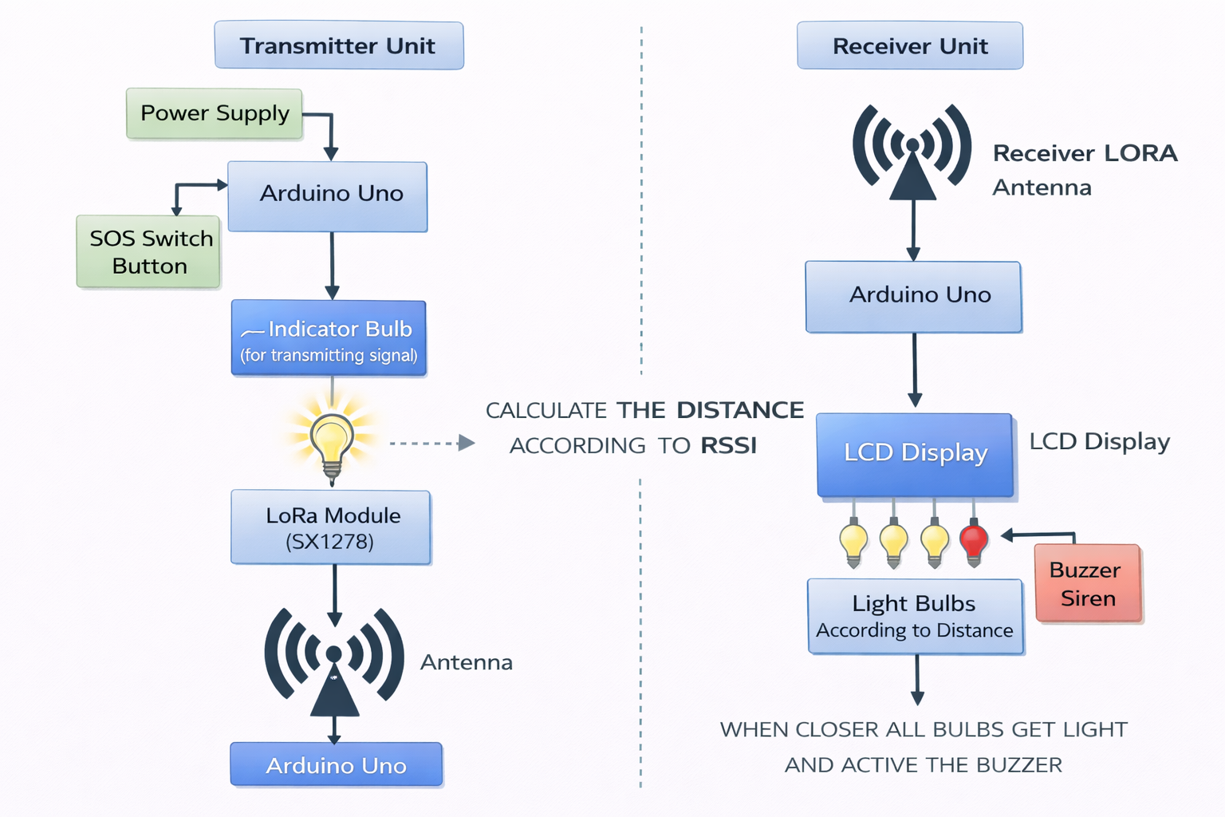
System Architecture
Transmitter LoRa Link Receiver

Slide 9
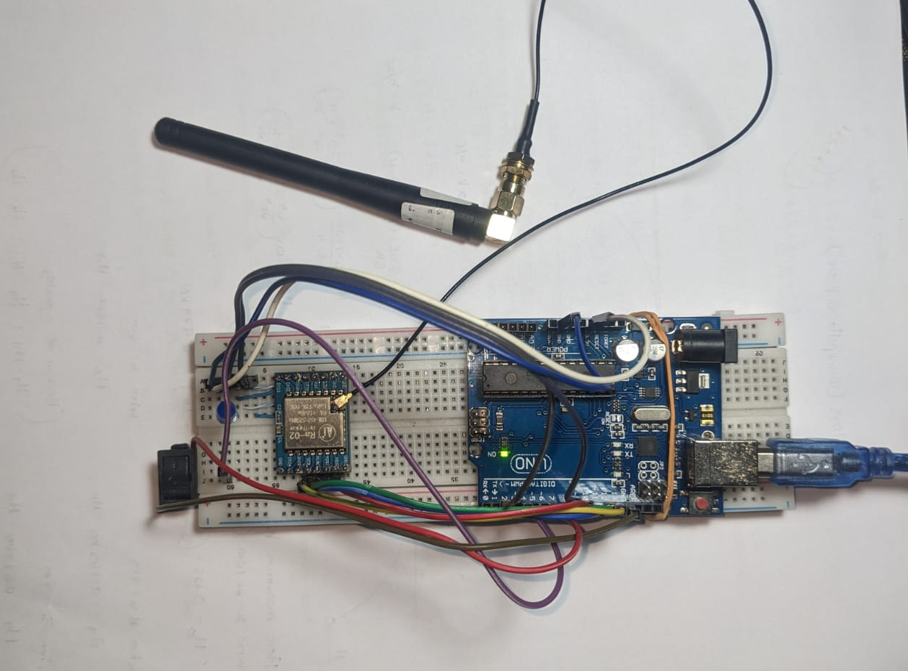
Beacon Transmitter (Person Tag)
Internal Components:
Arduino UNO
LoRa RA-02 module
SOS Push Button
TP4056 Charging Module
Functions:
Sends beacon message every few seconds
Sends SOS alert when button pressed
Powered by rechargeable battery

Slide 10
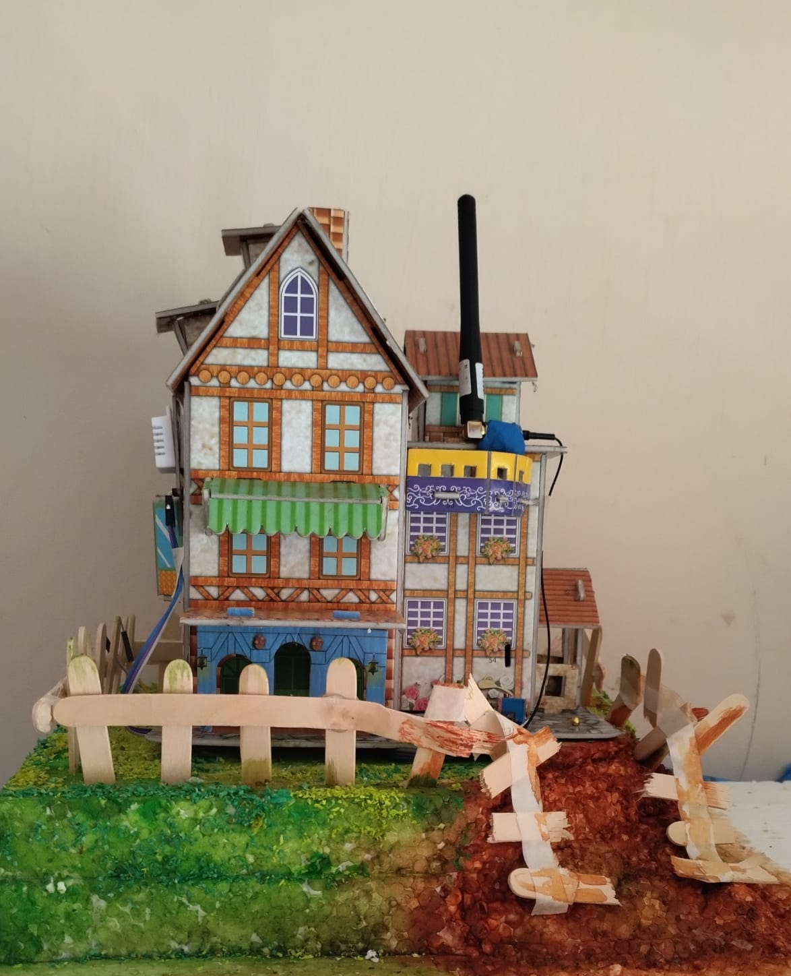

Slide 11
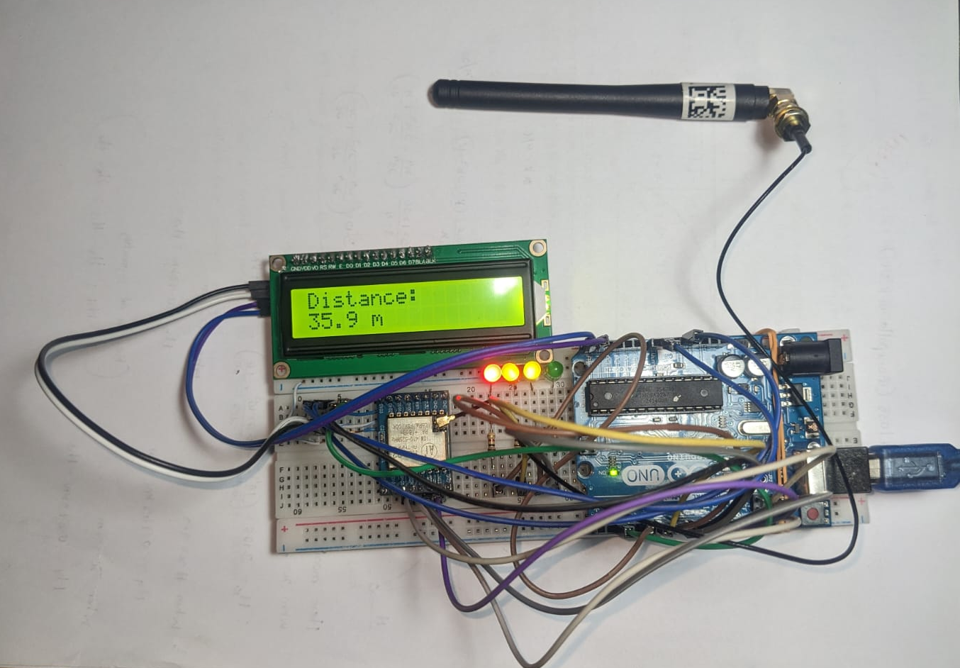
Beacon Receiver (Base Station)
Internal Components:
Arduino UNO
LoRa Receiver Module
LED Indicators (to show distance alert levels)
Buzzer (for SOS or critical distance)
Optional LCD Display
Functions:
Continuously listens for beacon packets
Determines distance roughly using RSSI
Visual and audio alerts

Slide 12
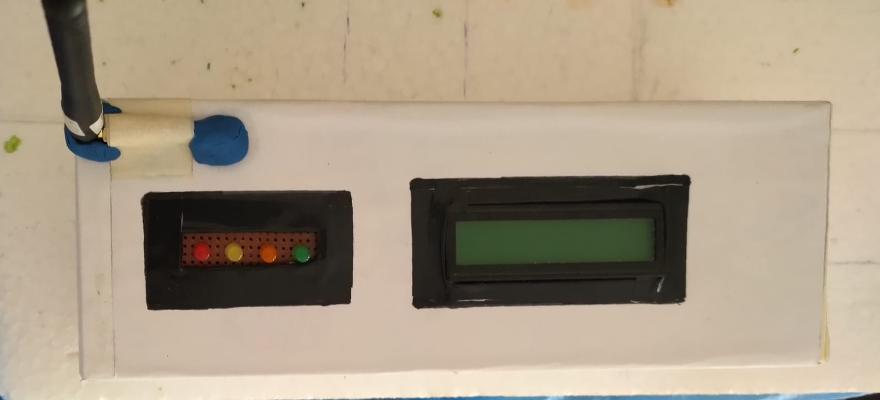

Slide 13

Challenges We Faced
Difficulty understanding LoRa configuration parameters (frequency, SF, bandwidth)
RSSI values not stable, making distance estimation challenging
LoRa cannot determine exact distance because RSSI is affected by multipath propagation, interference, and obstacles.
Initial breadboard wiring issues
LoRa communication failed until SPI wiring was corrected
Limited testing space for long-range communication

Slide 14
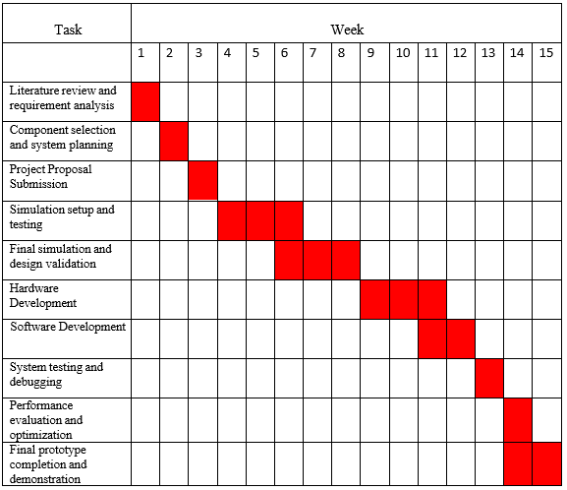
Timeline

Slide 15
Budget
Required Components | Quantity | Cost Estimation
Atmega328p-PU Microcontroller | 2 | Rs.1700.00
IPEX to SMA Cable WIFI 3G 4G GSM Female Wire 30cm | 2 | Rs.460.00
Lora Ra-02 SX1278 Module | 2 | Rs.3000.00
LED (Approx 10 pcs) |  | Rs.50.00
5V mini Buzzer | 1 | Rs.40.00
RF 433MHz Antenna | 2 | Rs.560.00
Total Cost |  | Rs.5810.00

Slide 16
Conclusion
LoRa provides a reliable emergency alert mechanism
System works independent of mobile networks
Current simulation shows system is functioning correctly
Prototype development is on track for hardware implementation
Helpful for disaster rescue operations

Slide 17
Group Members
2022/E/122 – RATHNAYAKE R.G.R.M.D.R
2022/E/175 – WEERASEKARA W.M.S.G.
2022/E/177 – SANDARUWAN W.P.P.C.
2022/E/179 – SUPUNTHAKA W.H.S.S.
2022/E/180 – PRASANJANA W.T.

Slide 18
THANK YOU

